Slide 1
Vector Semantics
Adam Goodkind
[Some graphics from Bhaskar Mitra’s (Microsoft) Introduction to Word Embeddings]

Slide 2
What is vector semantics?
Represent an item (e.g., word) as a vector of numbers.
Words are typically represented as (arbitrary) symbols
No relationship from one to the other, e.g.
“Cat” → ID143
“Dog” → ID537
No useful way to compare “cat” to “dog”
No way to learn anything about “dog” from learning “cat”
banana
0
1
0
1
0
0
2
0
1
0
1
0

Slide 3
What is vector semantics?
Represent an item (e.g., word) as a vector of numbers.
The vector can correspond to documents in which the word occurs.
banana
0
1
0
1
0
0
2
0
1
0
1
0
Doc2
Doc4
Doc7
Doc9
Doc11

Slide 4
What is vector semantics?
Represent an item (e.g., word) as a vector of numbers.
The vector can correspond to neighboring word context.
e.g., “yellow banana grows on trees in africa”
banana
0
1
0
1
0
0
2
0
1
0
1
0
(yellow, -1)
(on, +2)
(grows, +1)
(tree, +3)
(africa, +5)
-1
0
+1
+2
+3
+4
+5

Slide 5
What is vector semantics?
Represent an item (e.g., word) as a vector of numbers.
The vector can correspond to character trigrams in the word.
banana
0
1
0
1
0
0
2
0
1
0
1
0
#ba
na#
ana
nan
ban

Slide 6
Notions of Relatedness
Comparing two vectors (e.g., using cosine similarity) estimates how similar the two words are.
However, the notion of relatedness depends on what vector representation you have chosen for the words.
or
seattle similar to denver?
Because they are both cities.
seattle similar to seahawks?
Because “Seattle Seahawks”.

Slide 7
Vector Creation Example
We have four (tiny) documents,
Document 1 : “seattle seahawks jerseys”
Document 2 : “seattle seahawks highlights”
Document 3 : “denver broncos jerseys”
Document 4 : “denver broncos highlights”

Slide 8
Vector Creation Example - Document occurrence vectors
Document 1
Document 3
Document 2
Document 4
seattle
1
1
0
0
similar
seahawks
1
1
0
0
denver
0
0
1
1
similar
broncos
0
0
1
1

Slide 9
Vector Creation Example - Word context vectors
(seattle, -1)
(denver, -1)
(jerseys, + 1)
(highlights, +1)
(seahawks, +1)
(broncos, +1)
(jerseys, + 2)
(highlights, +2)
seattle
0
2
0
0
0
1
0
1
seahawks
2
0
0
0
1
0
1
0
similar
denver
0
0
0
2
0
1
0
1
similar
broncos
0
0
2
0
1
0
1
0

Slide 10
Vector Creation Example - Character trigram vectors
#se
set
ett
ttl
le#
sea
eat
att
tle
seattle
1
1
0
1
0
1
1
1
1
similar
settle
1
0
1
0
1
0
1
1
1
This notion of relatedness is similar to edit distance.

Slide 11
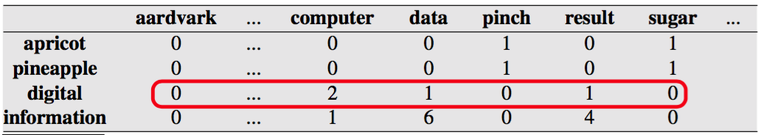
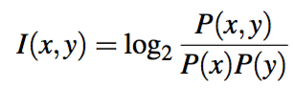
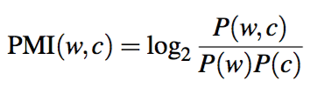
Weighting Terms - Pointwise Mutual Information (PMI)
Based on co-occurences with useful words
How often x and y occur together versus what we’d expect if they were independent
PMI weighting is more accurate than simple frequency

Slide 12

Weighting Terms - Term Frequency-Inverse Document Frequency (TF-IDF)
$$\frac{term frequency}{document frequency}$$
Higher term frequencies increase weighting
Higher document frequencies decrease weighting
Highlights “important” words
Words like and, but, the
Appear a lot in each document and also across all documents
Results in a low weighting
Words that are important
Appear a lot in a document and not in many documents
Results in a higher rating

Slide 13
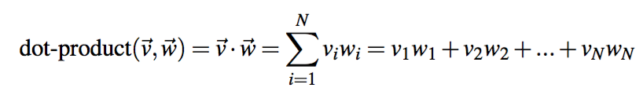
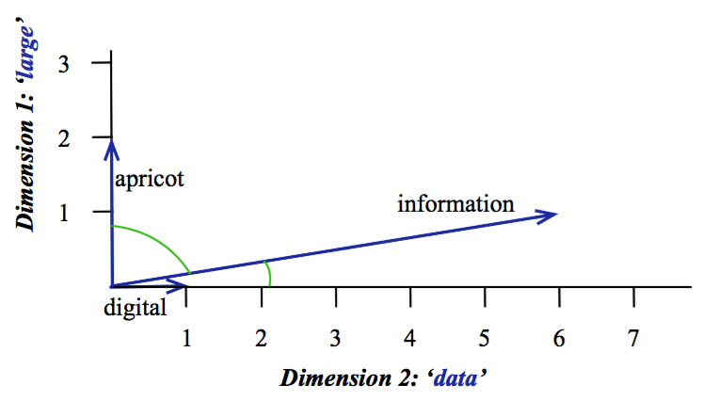
Comparing Vectors - Cosine similarity
Cosine of the angle between vectors
Based on vectors’ dot product

Slide 14
Comparing Vectors - Word analogies
Visually, analogous vectors tend to be almost parallel
- {Russia → Moscow} || {Spain → Madrid}
Mikolov, Sutskever, Chen, Corrado, and Dean, Distributed representations of words and phrases and their compositionality, NIPS, 2013.

Slide 15
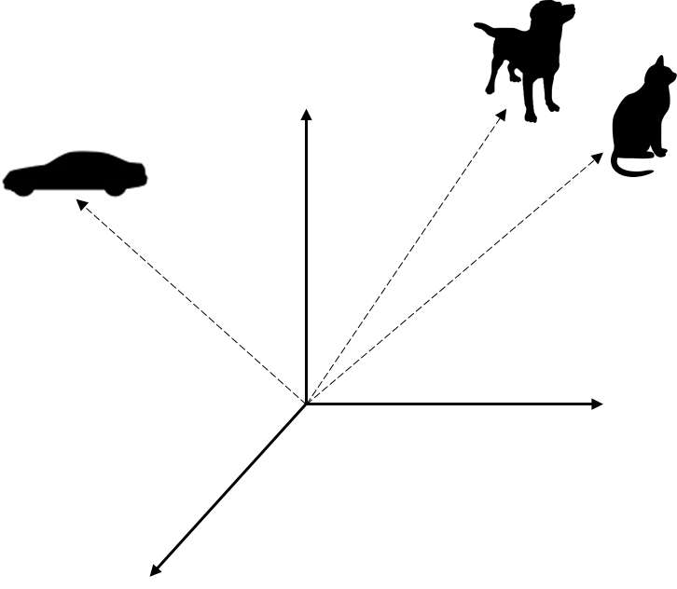
Embeddings
The vectors we have been discussing so far are very high-dimensional (thousands, or even millions) and sparse.
But there are techniques to learn lower-dimensional dense vectors for words using the same intuitions.
These dense vectors are called embeddings.

Slide 16
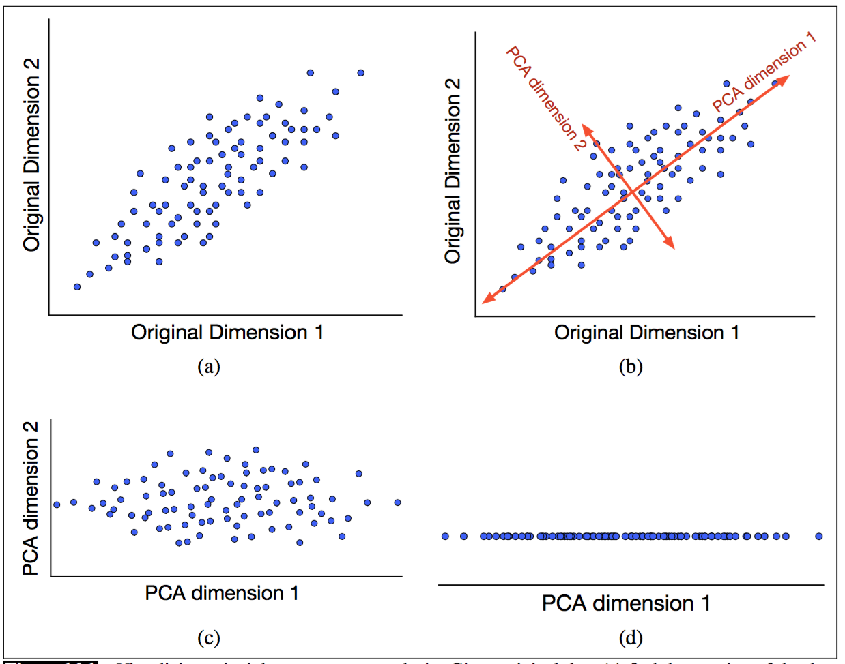
Sparse → Dense Vectors
Reduce dimensions to the most informative
Similar to Principal Component Analysis (PCA)

Slide 17
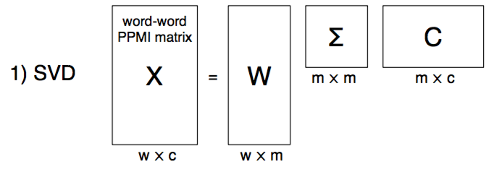
Sparse → Dense Vectors - SVD (Singular Value Decomposition)
X = |V | x c
W = |V | x m
m is orthagonal dimensions ordered by variance (informativeness)
Σ = m x m
diagonal matrix of importance of each dimension
C = m x c
Each row is a latent dimension
Each column is still a document or context

Slide 18
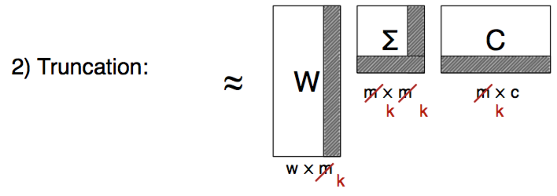
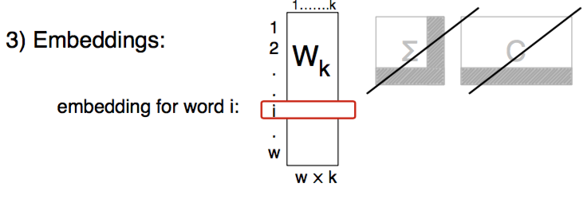
Sparse → Dense Vectors - SVD → LSA (Latent Semantic Analysis)
Select k dimensions and truncate
May help a model generalize better over uncertain data
LSA has been proposed as a cognitive model

Slide 19
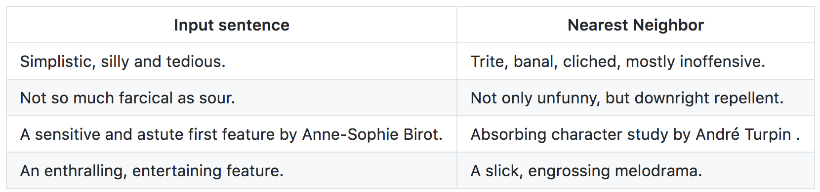
Beyond Words - Skip-thought vectors
Encodes each sentence as a vector
Useful for paraphrase detection
Sentiment analysis
https://github.com/tensorflow/models/tree/master/skip_thoughts

Slide 20
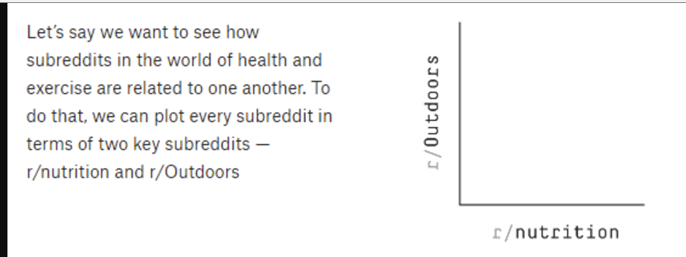
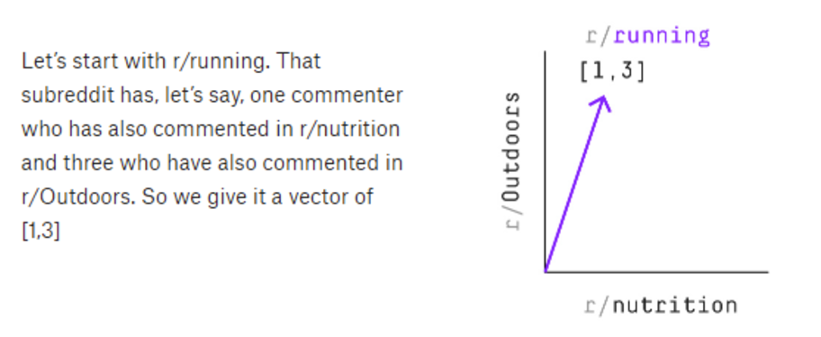
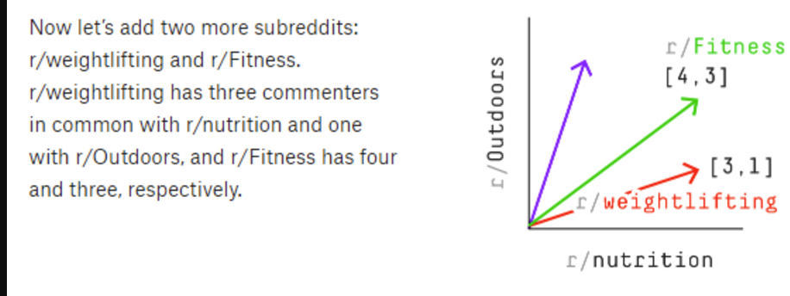
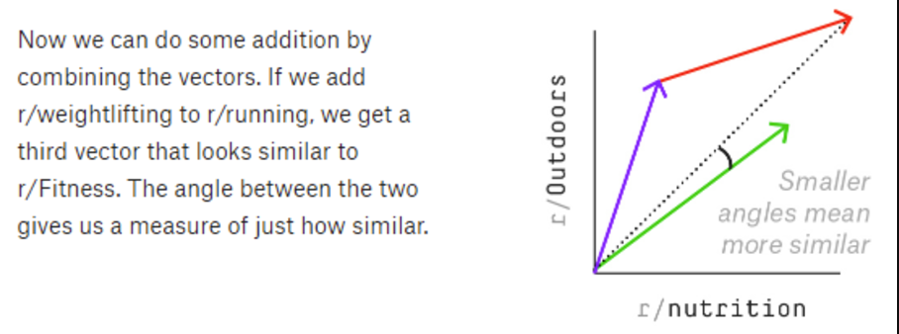
Beyond Words - Reddit analysis
Used by FiveThirtyEight
r/TheDonald + r/UncensoredNews = r/HillaryForPrison

Slide 21
Some issues
Both Word2vec and GloVe define context as the neighboring word only, without considering the distance from the current word.
How does this change the relationship that is learnted by the embedding space?

Slide 22
What’s next?
Train your own or use a pre-trained embedding
Word2vec
Word2vec trained on queries
GloVe
DSSM

